Slide 1


Movie Robot
Ya Yi, Wei-Ning Liang, Chiao-Tung Yang

Slide 2
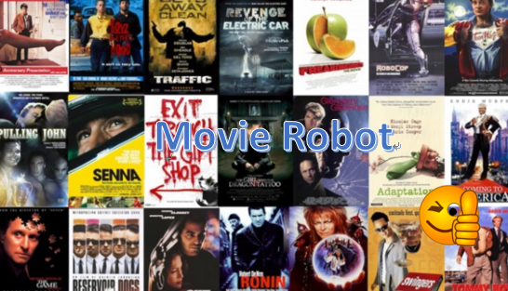
Background
How can we have a quick review for a selected movie?
How can we get insightful information from thousands of movies?
How can we quickly get some recommendation movies?

Slide 3
Project Overview
Data analysis
Implement major functionalities
Use Case 1: General information of a movie
Use Case 2: Statistic information of all movies
Use Case 3: Recommend top-10 movies based on year / genre
Data visualization and application integration
Tests
Add travis for CI

Slide 4

Data Sets
4804 movies
From 1916 to 2017
Attributes:
Genres
link
Language
Production company
Release date
Average votes
...

Slide 5
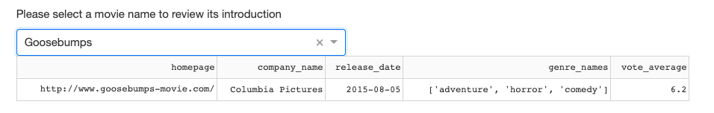
Functional Specifications
Use case 1: Get general information of a movie
Given a known movie title, the movie-robot will return the basic information, like release date, production companies, genres, .etc.
Use textbox to input a movie name or select a movie from the dropdown menu

Slide 6
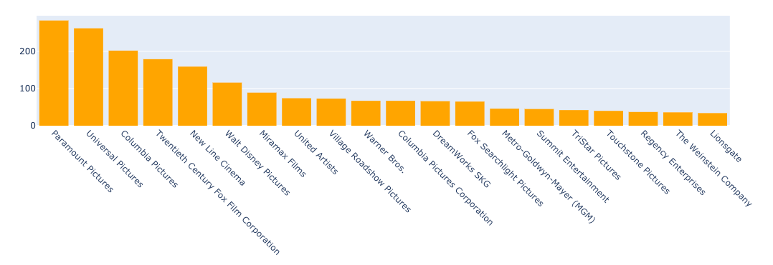
Functional Specifications
Use case 2: Get statistic information of all / selected movies
Example 1: Number of movies made by different companies
Notes:
For user case 2, we will use different visualization tools to make user have more insightful information based on all data or a selected group of data.

Slide 7
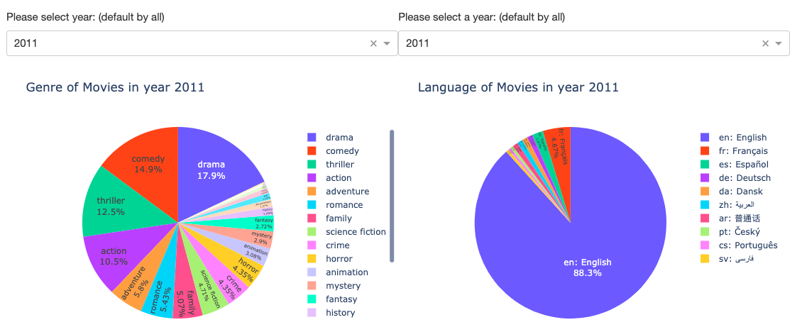
Functional Specifications
Use case 2: Get statistic information of all / selected movies
Example 2: select year to get distribution of genre / language

Slide 8
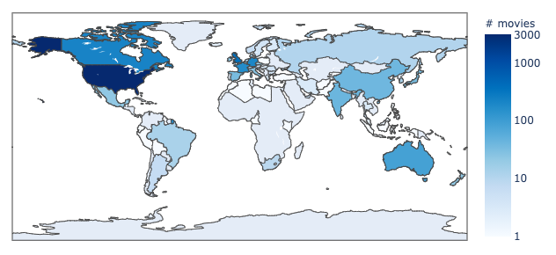
Functional Specifications
Use case 2: Get statistic information of all / selected movies
Example 3: Geo-graph of movies production countries

Slide 9
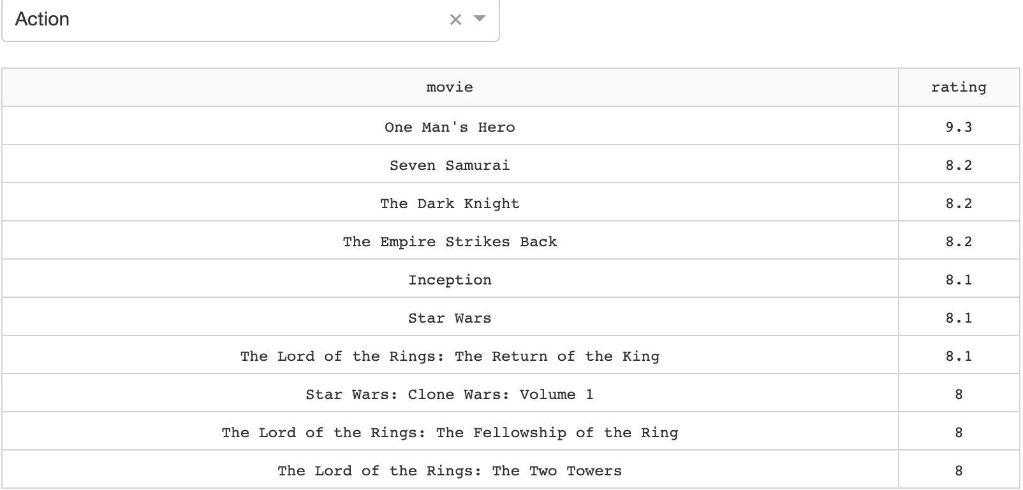
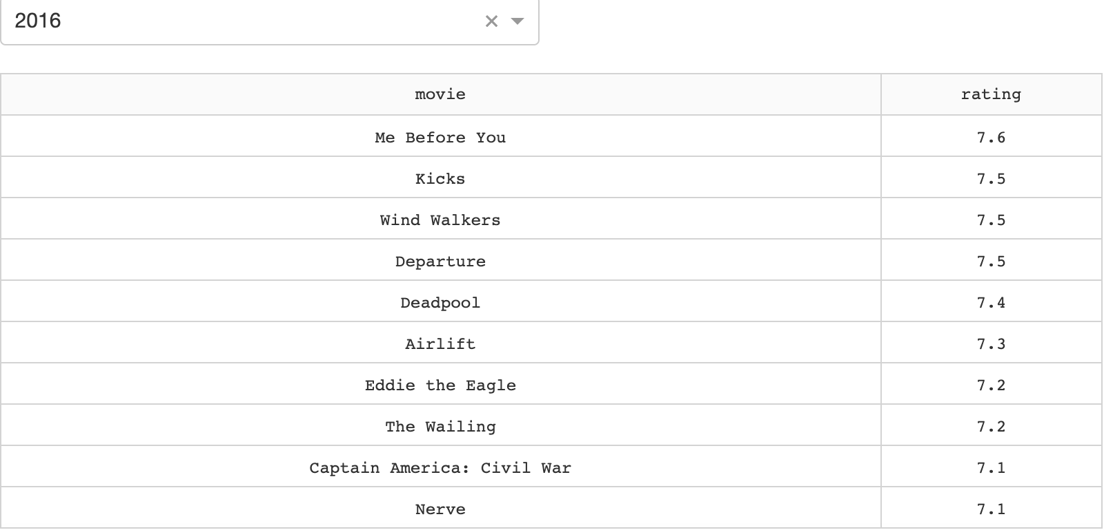
Functional Specifications
Use case 3: Recommend top-10 movies based on genre / year
Metrics: Average votes

Slide 10
How to get setup and run the App?
git clone <repo url>
cd into the folder
install conda
conda create -n <env_name> python=3.8 -f envs.yml
run ./start.sh and open `localhost:8088` in your favorite browser
Explore and enjoy `movie-robot`.

Slide 11
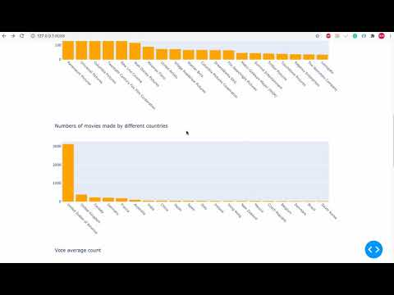
Demo

Slide 12
Lessons Learned and Future Work
Use unit tests to test functionality.
Implement a web application framework using Dash.
Draw statistics graphs with plotly.
Create .py file to set up the environment for our project.
How to properly pull, push and merge our repository.
Add more unit tests and use travis to implement continuous integration (CI).
Train a machine learning model to predict the recommended movies.
Deploy our movie-bot on mobile app.
Add functionality that allow users to rate the movies.
Create database for our data and allow real-time queries.

Slide 13
Thank you!

